Slide 1

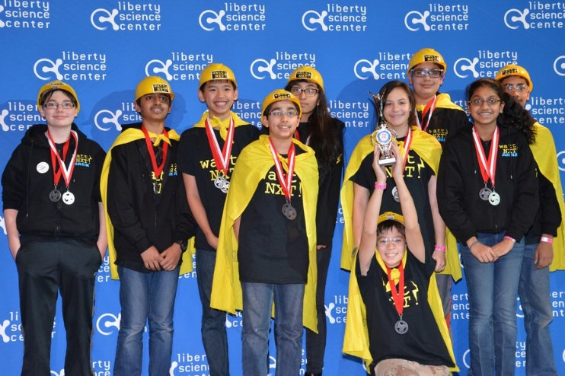
Who Are We?
Team 7350 Watt NXT from Edison NJ
We are a collection of 14 kids from the same county that have a similar interest in robotics
Our team is part of the FIRST organization and we are involved with FTC
We promote science and technologies among children of all ages and love doing it

Slide 2
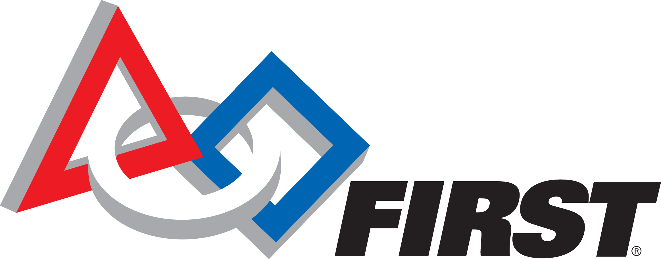
What is FIRST
For Inspiration and Recognition for Science and Technology

Slide 3
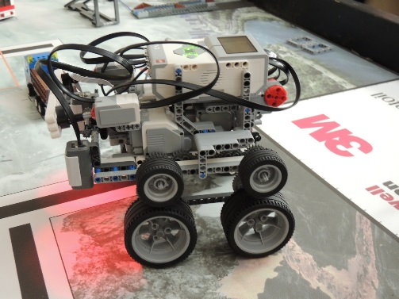
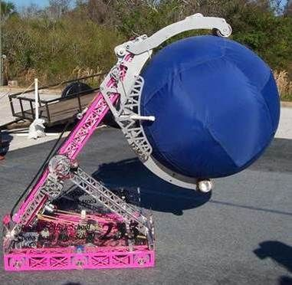
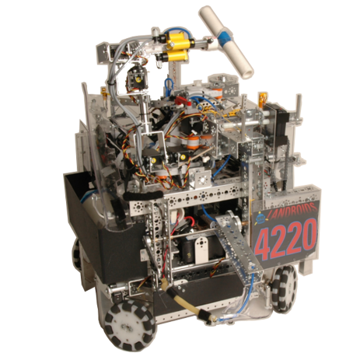
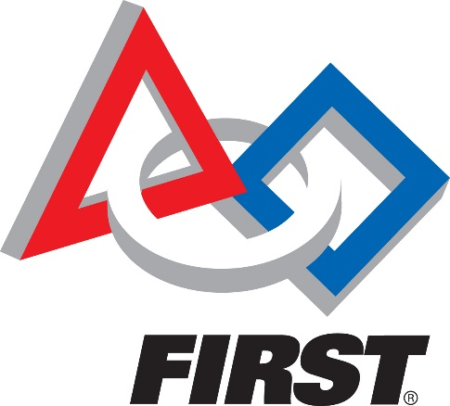
Levels of FIRST
JR. FLL-- For children ages 6-9, Junior FIRST® LEGO® League (Jr.FLL®) captures young children's curiosity and directs it toward discovering the wonders of science and technology.
FLL-- Introduces younger students to real-world engineering challenges by building LEGO-based robots to complete tasks on a thematic playing surface.
FTC-- is designed for students in grades 7-12 to compete head to head, using a sports model. Teams are responsible for designing, building, and programming their robots to compete in an alliance format against other teams.
FRC-- combines the excitement of sport with the rigors of science and technology. Under strict rules, limited resources, and time limits, teams of 25 students or more are challenged to raise funds, design a team "brand," hone teamwork skills, and build and program robots to perform prescribed tasks against a field of competitors.

Slide 4
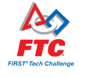
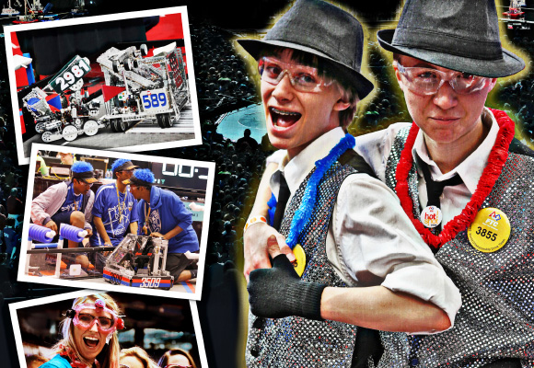
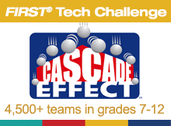
FTC
FTC stands for FIRST Tech Challenge
Designed for students in grades 7 – 12 to participate in robotics competitions
Instills the values of hard work, creativity, and innovation
Develop problem solving, organizational, and team building skills
Apply real world science and mathematics
Students get to design, build, and program robots

Slide 5
Benefits

Slide 6
Our Goal

Slide 7
What We Have Done

Slide 8
PPMD Conference

